Slide 1

E-Commerce Product Performance Analysis
This E-Commerce Product Performance Analysis provides a data-driven overview of how products perform across key metrics such as sales, conversion rates, customer engagement, and profitability. The goal is to identify top-performing items, uncover market trends, and highlight improvement areas to optimize pricing, inventory, and marketing strategies—ultimately driving better decision-making and sustainable business growth.

Slide 2

Project Overview
Our Mission
This comprehensive analysis project examines online sales data to unlock critical insights about business performance and customer behavior patterns.
Through strategic data analysis and interactive visualization, we identify opportunities for revenue optimization and customer experience enhancement.

Slide 3




Analytical Tools & Technology Stack
Excel
Power BI
Initial data cleaning, validation, and foundational visualization using pivot tables and conditional formatting
Advanced interactive dashboards with DAX calculations and dynamic reporting capabilities
Python
SQL
Exploratory data analysis, statistical modeling, and sophisticated visualization with Pandas and Matplotlib
Efficient querying, data extraction, and aggregation of large-scale datasets for analysis

Slide 4

Dashboard Development Process
01
02
Excel Foundation
Power BI Enhancement
Data imported and cleaned using advanced filters and formulas, followed by pivot table creation for data summarization and initial chart visualization
Professional dashboard built with bar, column, and pie charts, enhanced with DAX functions for KPI calculations and interactive slicers
03
Python & SQL Analysis
Deep exploratory analysis performed using Python libraries, with SQL queries extracting key metrics to establish analytical foundation

Slide 5
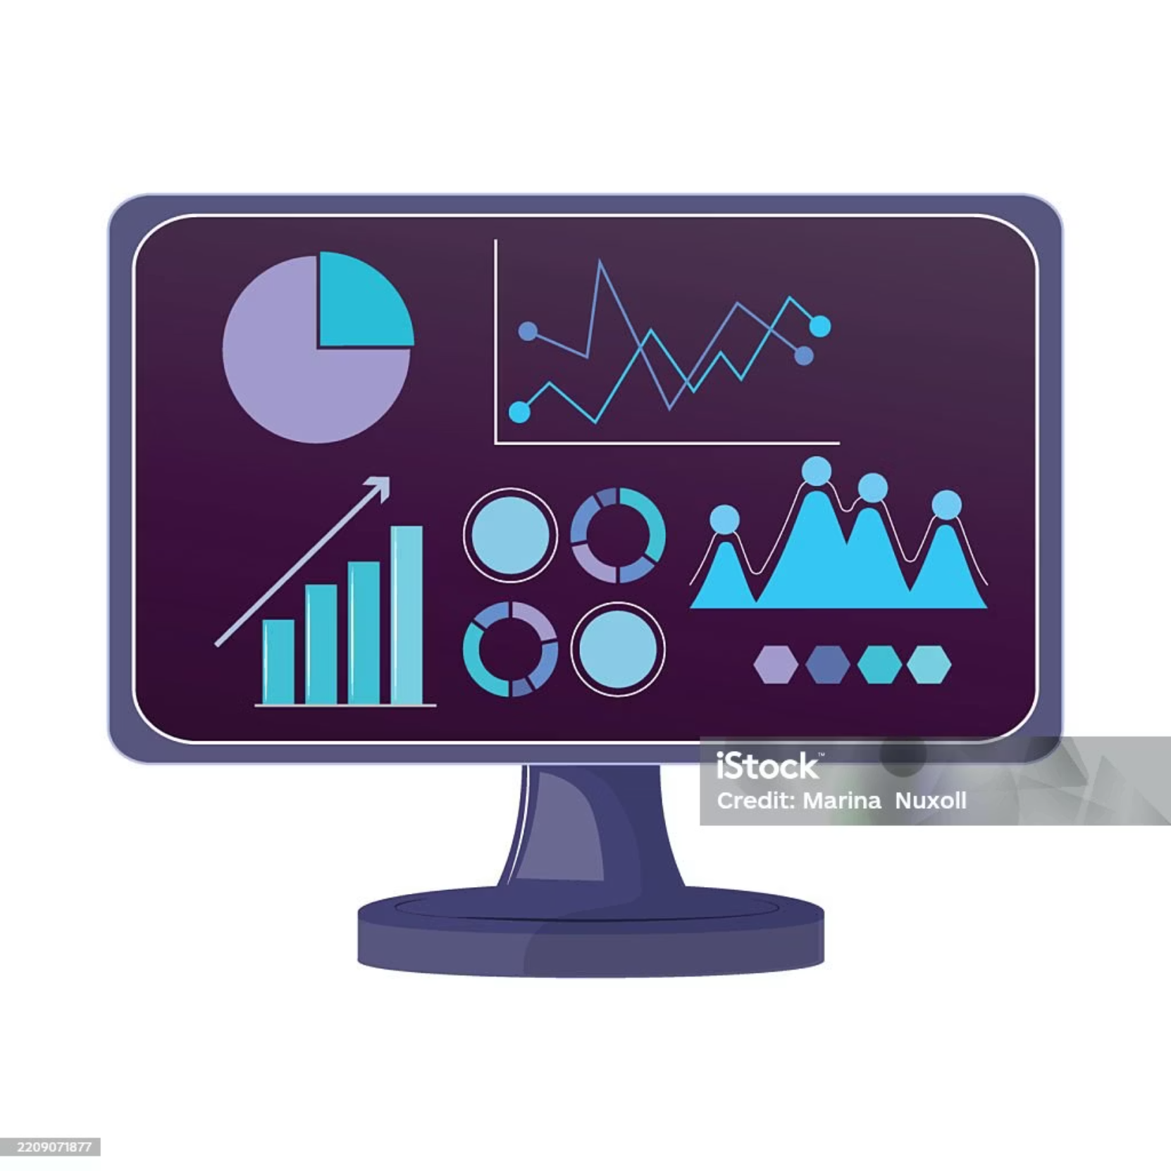
Dashboard Components
Core Analytics Modules
Sales Analysis: Monitors total revenue streams and identifies temporal trends
Profit Analysis: Pinpoints high-performing products and lucrative regional markets
Customer Behavior: Tracks purchase patterns, satisfaction ratings, and return frequencies

Slide 6
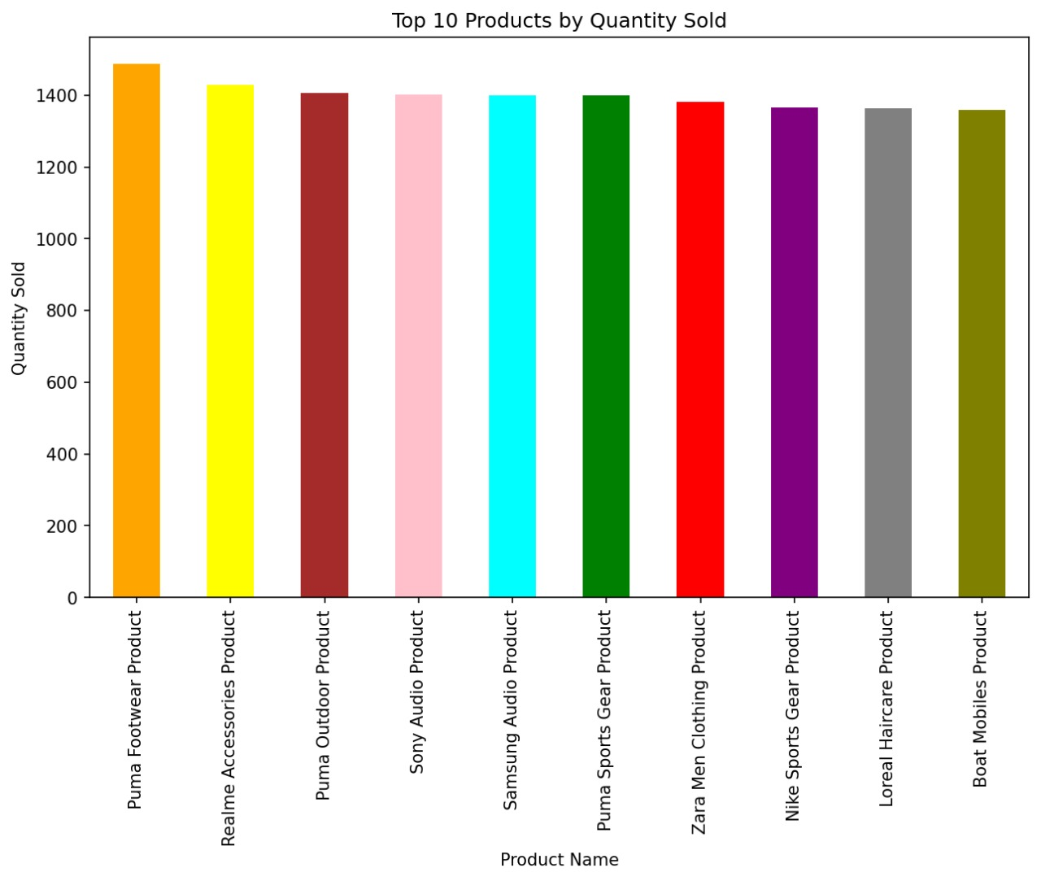
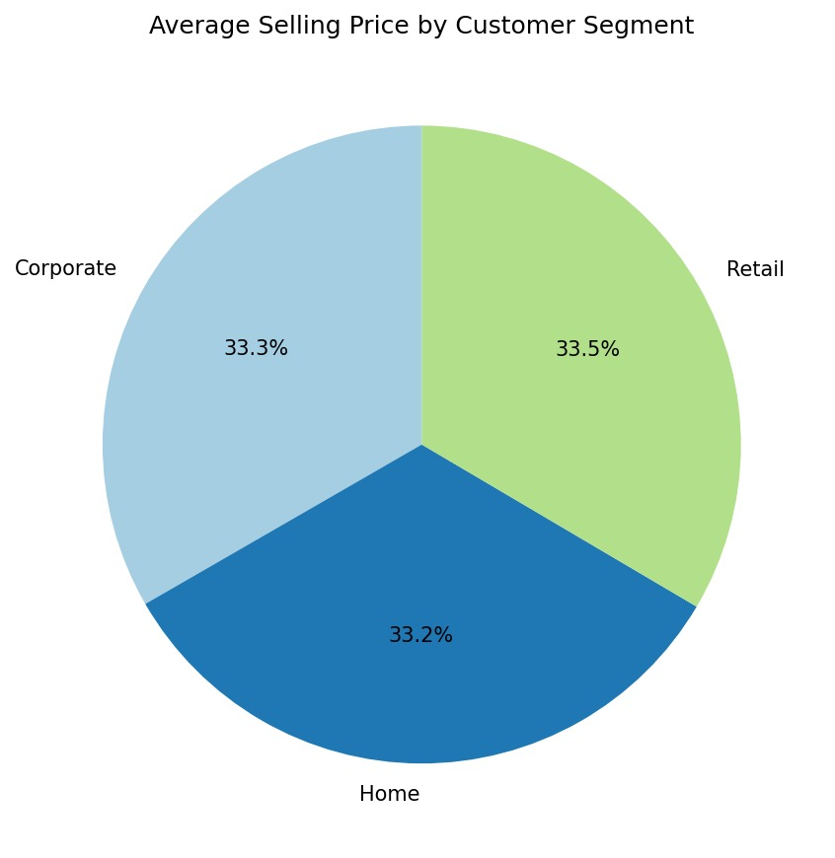
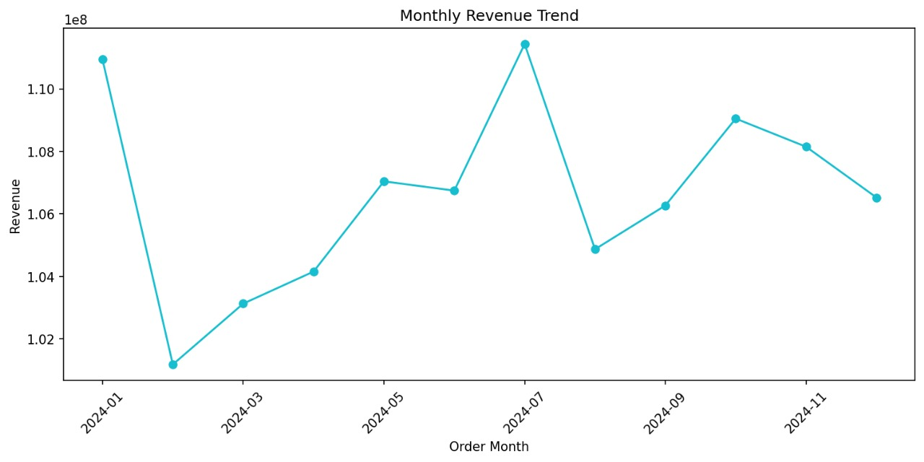
Visualization Strategy
Bar & Column Charts
Pie & Doughnut Charts
Line Charts
Compare categories and track performance across dimensions
Display proportional relationships and market share distribution
Reveal temporal trends and seasonal patterns in sales data

Slide 7
Key Performance Indicators
₹427.28M
₹27.20M
2.99
22%
Total Revenue
Total Profit
Average Rating
Profit Margin
Comprehensive sales across all channels and categories
Net earnings after cost deductions and returns
Customer satisfaction score out of 5.0
Average profitability across product portfolio

Slide 8
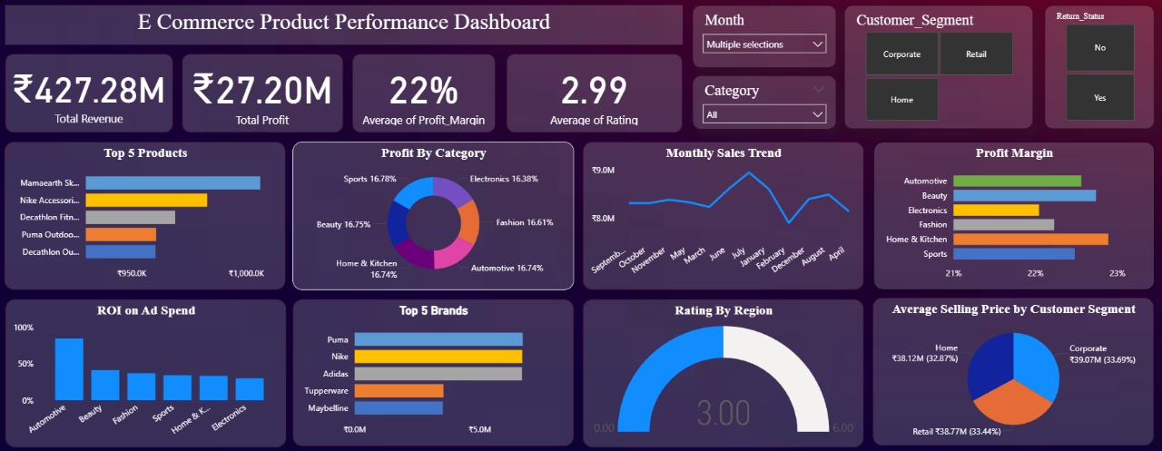
Interactive Filtering Capabilities
📅 Month Filter
🏷️ Category Filter
Analyze seasonal trends and monthly performance variations
Drill down into specific product categories and subcategories
👥 Customer Segment
↩️ Return Status
Compare behavior across consumer, corporate, and home office segments
Identify patterns in returned versus retained purchases

Slide 9

Conclusion & Impact
Driving Strategic Decision-Making
This project successfully integrates multiple analytical tools to deliver comprehensive business intelligence. By combining Excel, Power BI, Python, and SQL, we've created a powerful framework for understanding e-commerce performance.
Key Achievement: The interactive dashboard empowers stakeholders to identify growth opportunities, optimize product mix, and enhance customer satisfaction through data-driven insights.
Strategic planning becomes more agile and informed, enabling rapid response to market trends and customer preferences.

Slide 10
Thank You👍

